Slide 1


Parallel Searches
Team Parallel Professional
Group member:
Gabriel Toban
Khem Poudel
Toheeb Biala

Slide 2
Outline
Logic
Code
Results
Challenges

Slide 3
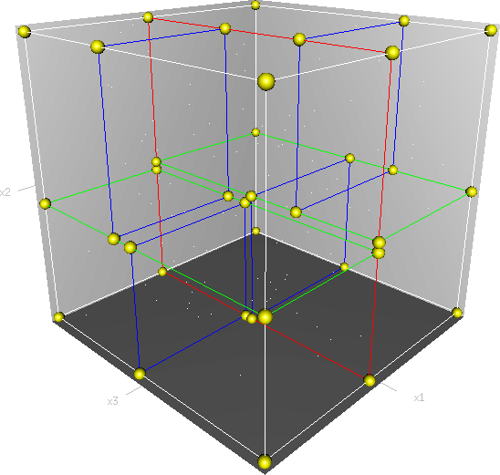
Introduction
k-d tree is a data structure used for organizing some number of points in a space with k dimensions.
Parallel k-d tree construction requires sorting
data across ranks using MPI
Goals:
Build k-d tree with 10 billion points
Search k-d tree for 20 million targets
Search using 3 radii
Source:Wiki

Slide 4
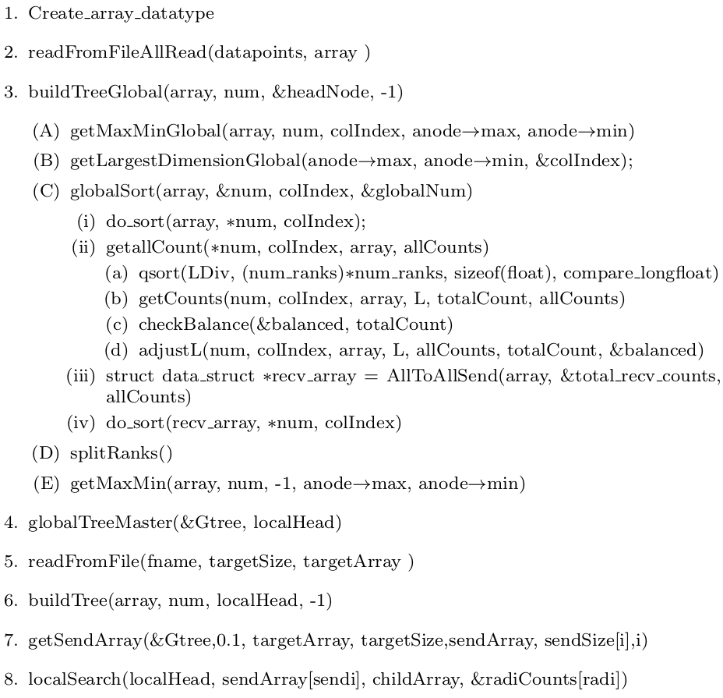
Functions Outline

Slide 5
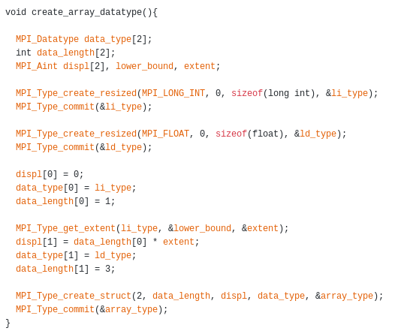
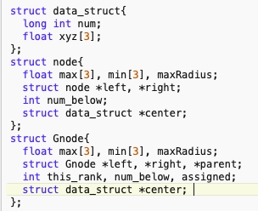
Data Structures
New MPI data type

Slide 6
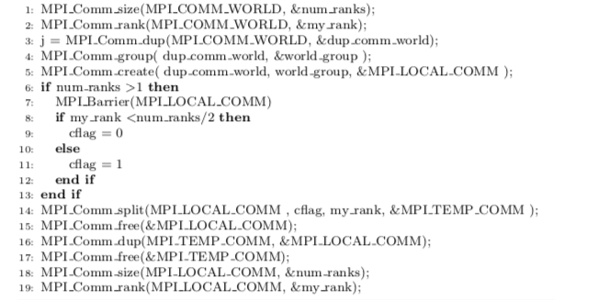
Create Comms

Slide 7
Tree Traversal: 4 Methods
Recursive
Relic
Most Memory Usage
Sequential Flags
Used for Global Tree Build Rank 0
Traverses Tree from Leaf to Head
Requires a flag variable in struct
Extra Memory Usage
Sequential Array: Adjust Index
Used for targetSize and targetArray
Elements are moved around child array
Slower than Round Robin by 10^2
Sequential Array: Round Robin
Used for local search
Element indexes managed in child array

Slide 8

Sequential Flag Method

Slide 9
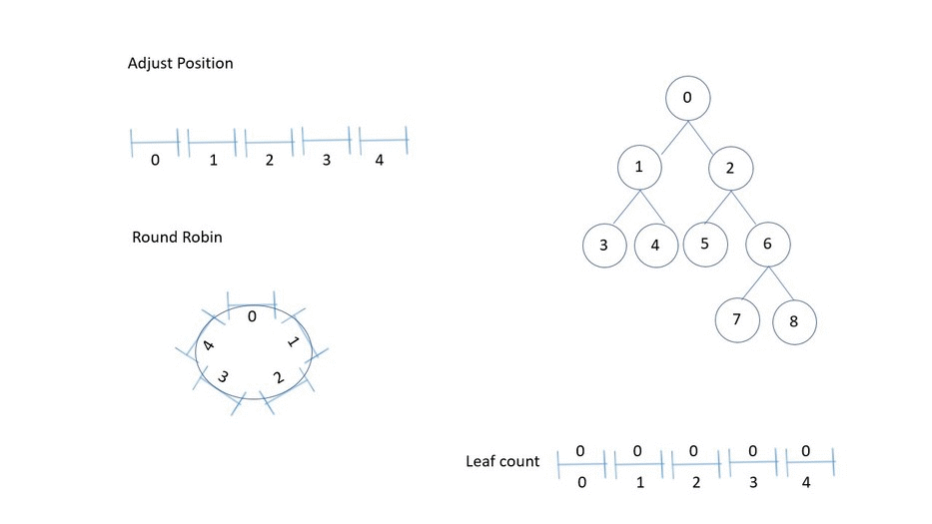
Sequential Array Methods

Slide 10
Node Split Logic
Split line
This process requires sorting, dividing, and moving the data around all the ranks until It uses the local heads of all ranks to build the global tree. An empty tree with num$\_$ranks leaves is built. Then the leaves of the global tree is then filled by receiving the maximum and minimum of the leaf from the other ranks in the order num$\_$ranks-1, num$\_$ranks-2, $\cdots$, 2, 1. Each node in the tree holds the following information.
This process requires sorting, dividing, and moving the data around all the ranks until It uses the local heads of all ranks to build the global tree. An empty tree with num$\_$ranks leaves is built. Then the leaves of the global tree is then filled by receiving the maximum and minimum of the leaf from the other ranks in the order num$\_$ranks-1, num$\_$ranks-2, $\cdots$, 2, 1. Each node in the tree holds the following information.
This process requires sorting, dividing, and moving the data around all the ranks until It uses the local heads of all ranks to build the global tree. An empty tree with num$\_$ranks leaves is built. Then the leaves of the global tree is then filled by receiving the maximum and minimum of the leaf from the other ranks in the order num$\_$ranks-1, num$\_$ranks-2, $\cdots$, 2, 1. Each node in the tree holds the following information.
Child A Actual Y Dimension
A
B
Child A Inherited Y Dimension
Parent Actual Y Dimension
Parent Actual Y Dimension
Child B Actual Y Dimension
Child B Inherited Y Dimension
Child A Actual X Dimension
Child B Actual X Dimension
Parent Actual X Dimension

Slide 11
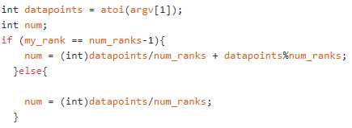
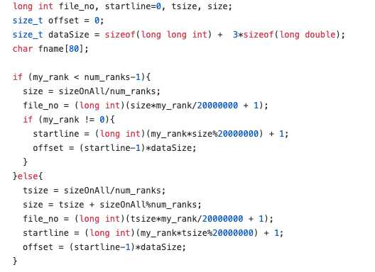
Read data points
{
offset0
file_no = 1
R0
file_no = 2
num0
{
offset1
R1
file_no = 3
num1
file_no = 4
file_no = 500

Slide 12

Get Local Head

Slide 13
00\
R0,R1,R2,R3,R4
Get Local Head
R0, R1
R2,R3, R4
R0
R1
R3, R4
R2
R3
R4

Slide 14
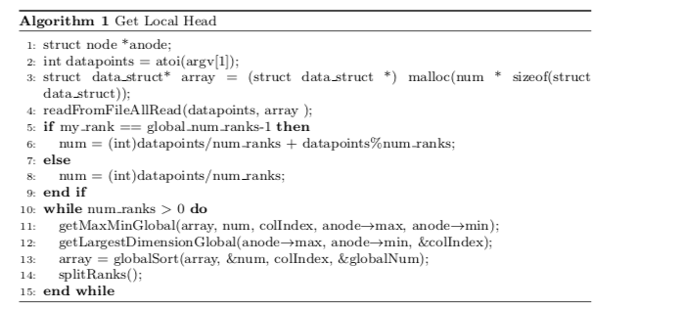
Get Local Head

Slide 15
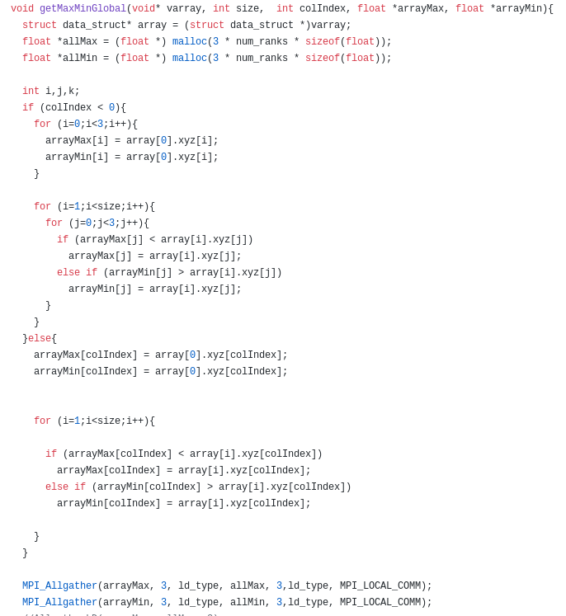
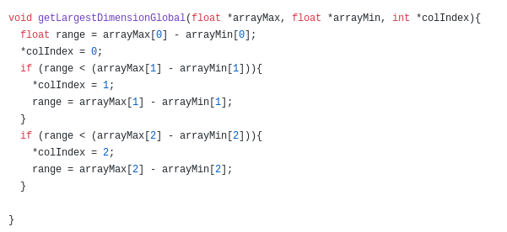
GetMaxMinGlobal
Get Largest Dimension

Slide 16
Global Sort
localsort
getBuckets
adjustBuckets
SendItems
localsort

Slide 17
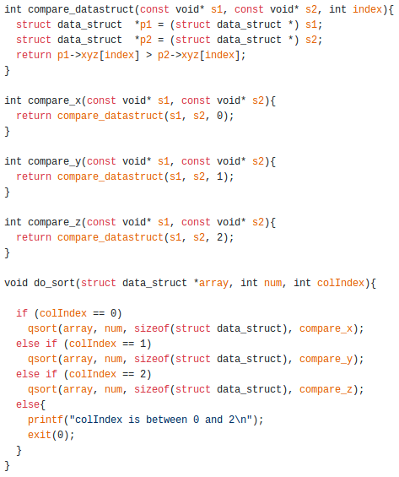
localsort

Slide 18
GetBuckets
lij = jth local lower limit for ith rank
R0
R1
R2
Min | li1 | li2 | Max
l10 | l11 | l12 | l13
l20 | l21 | l22 | l23
l30 | l31 | l32 | l33
SORT
l10
l11
l12
l13
l20
l21
l22
l23
l30
l31
l32
l33
Lj = jth global lower limit
L0=l30, L1=l11, L2=l22, L3=l13
L0-2 | N/A | N/A | L3
l30 | l20 | l10 | l31
l11 | l21 | l12 | l32
l22 | l33 | l23 | l13
L0
L1
L2
L3
L0
L1
L2
L3
L0
L1
L2
L3

Slide 19
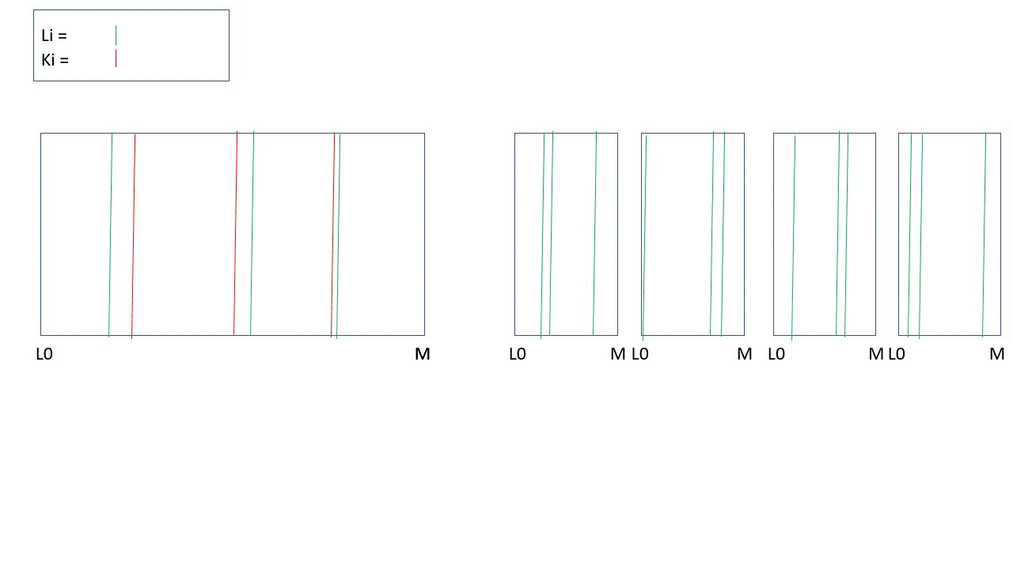
AdjustBuckets

Slide 20
R0
R1
R2
R3
R4
00
00
00
00
00
00
00
00
00
00
00
00
00
00
00
Global Tree on Each Rank
00
00

Slide 21
Build Global Tree Rank 0 Down

Slide 22
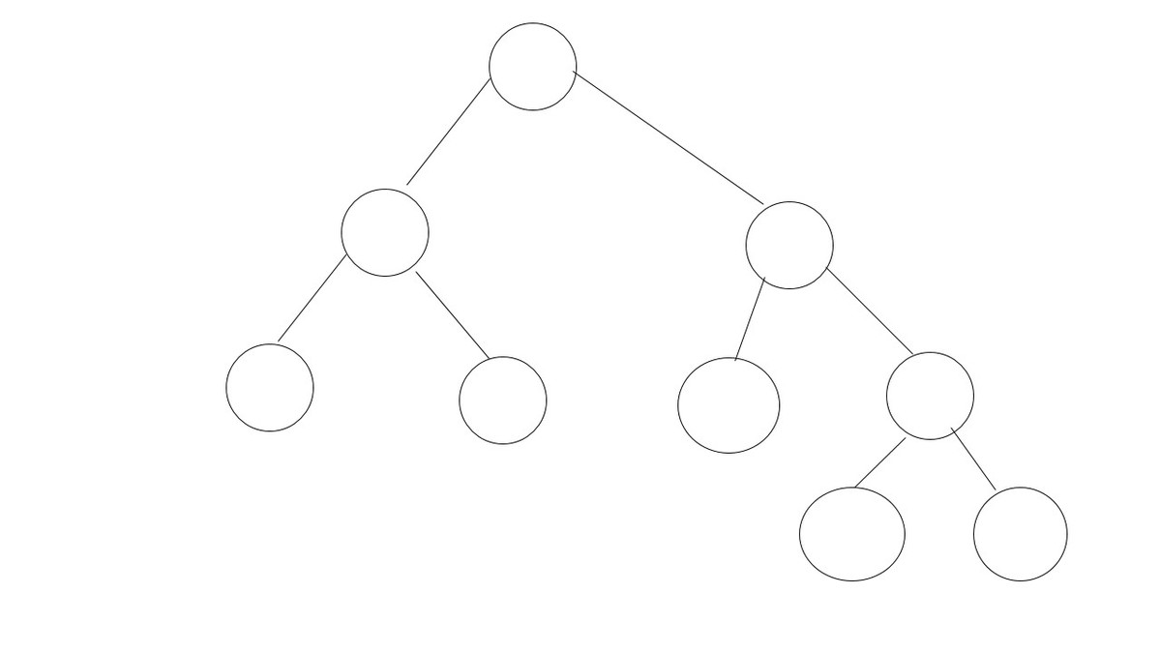
Build Global Tree up

Slide 23
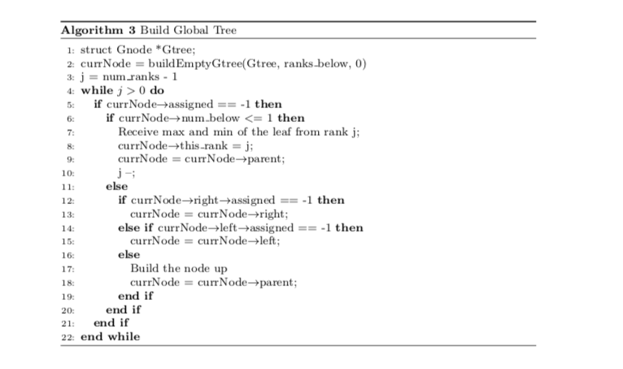
Build Global Tree (Sequential Flag)

Slide 24
Read Target
Only the master rank reads the target file named file501
Number of targets read is specified as a command line argument.
The file is converted to binary and stored as long doubles as discussed in the ”Read datapoints” section

Slide 25
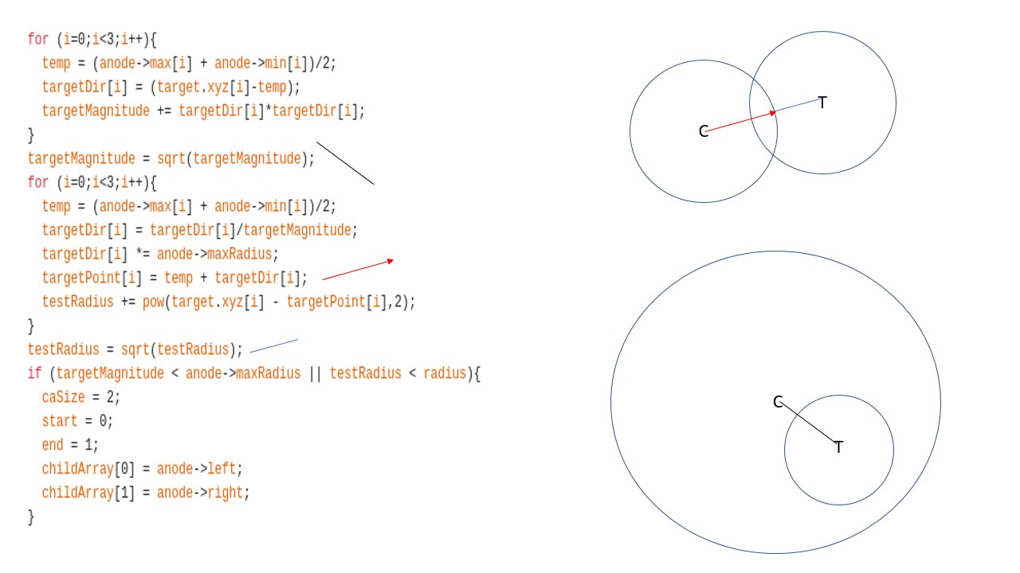
Search Comparison Logic

Slide 26
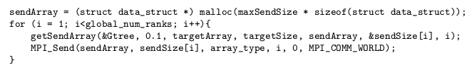
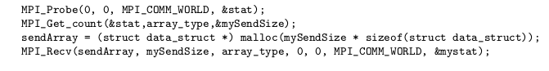
Get Targets (Round Robin)
For Master rank
For other ranks

Slide 27
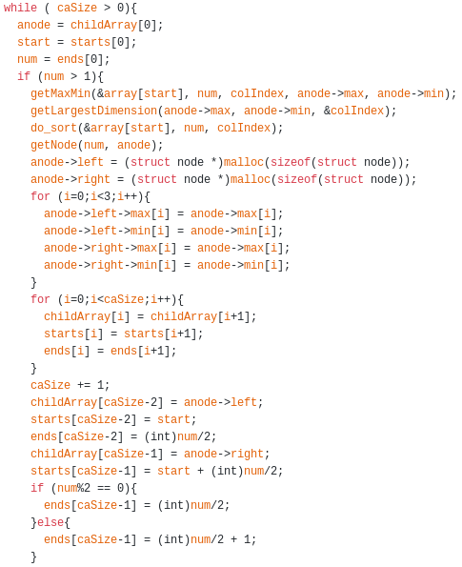
Build Local Tree (Adjust Index)

Slide 28
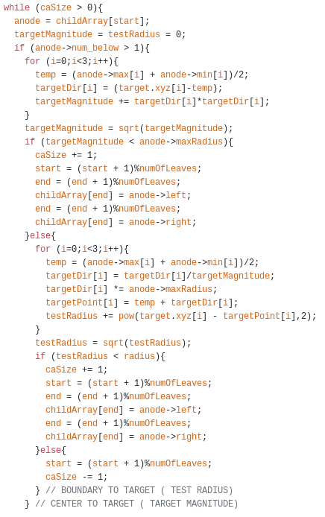
Local Count (Round Robin)
Get number of datapoints within radius of target
Same Logic as getSendArray
Send total counts to master rank

Slide 29
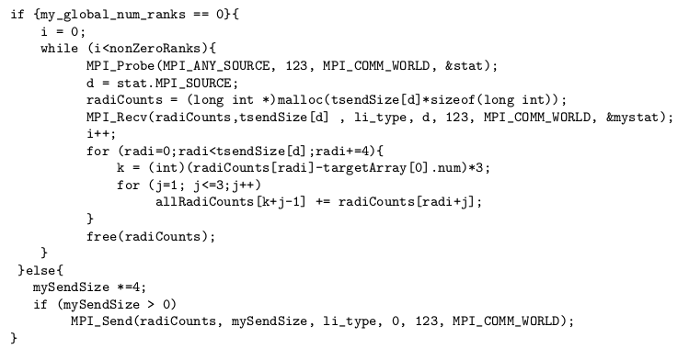
Global Count
Master rank receives counts from other ranks
Sum up all counts for a given target with a radius
Displays final outputs
0 <= assignedi < number of targets assigned to rank
radiCounts[assignedi] = [id1,x1,y2,z2,id2,x2,y2,z2, …. idn,xn,yn,zn]
0 <= k < number of targets (k represents target id)
allRadiCounts[k] = [x1,y1,z1,x2,y2,z2, … xn,yn,zn]

Slide 30
Validation
Used file001 to validate our code
Used a function named 'targetTest.c' to verify if a point is within the radius of the target.
Compared the result of targetTest.c with the result of our program for file001 and file501
Matched the global tree leaves with the local tree heads.

Slide 31
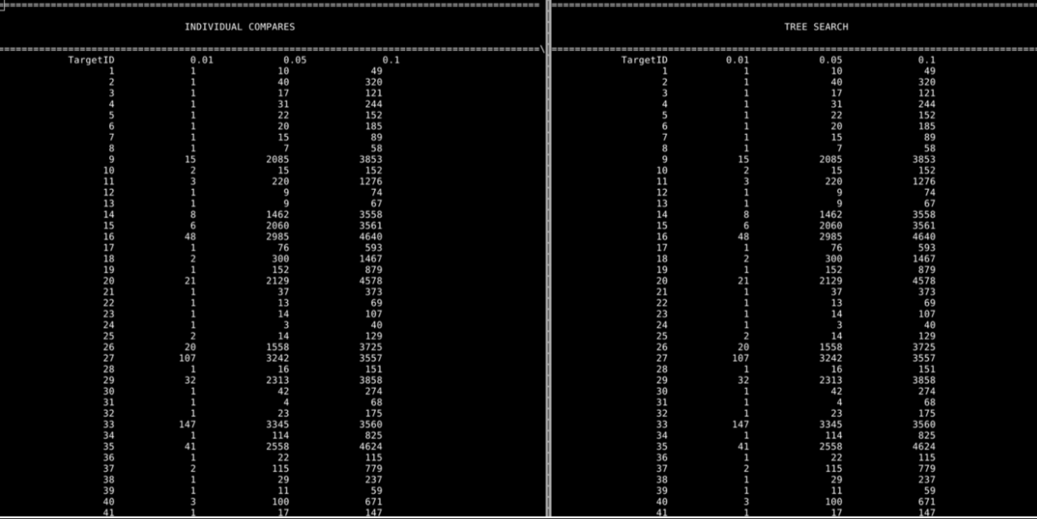
Validation File 001

Slide 32
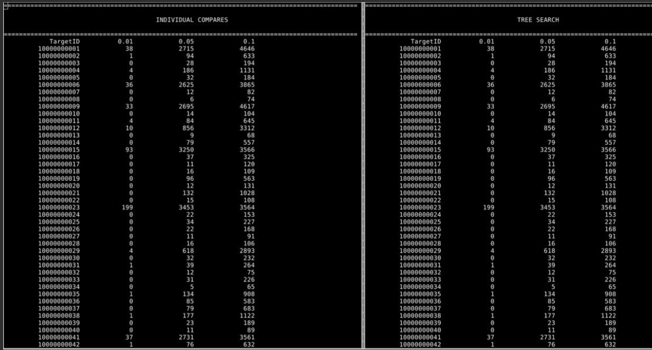
Validation file 501

Slide 33
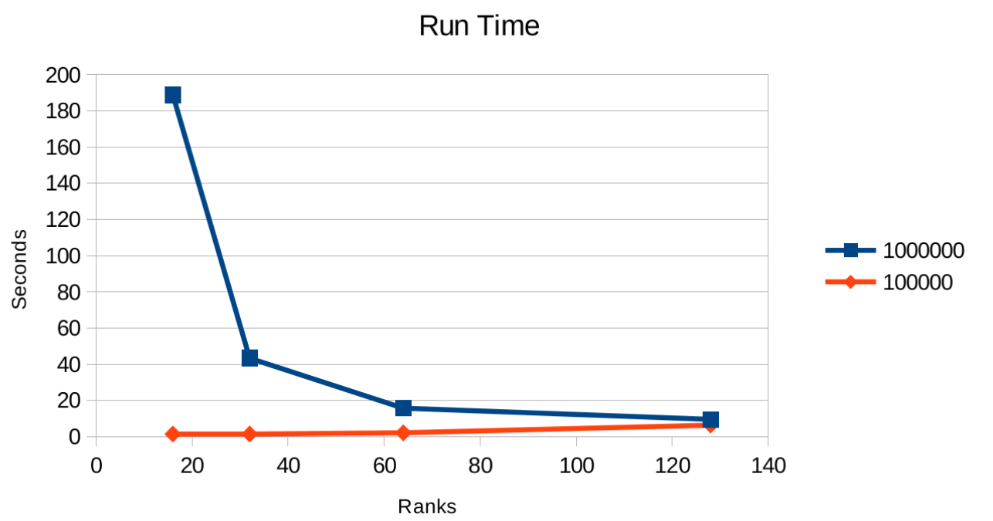
Timing Data

Slide 34
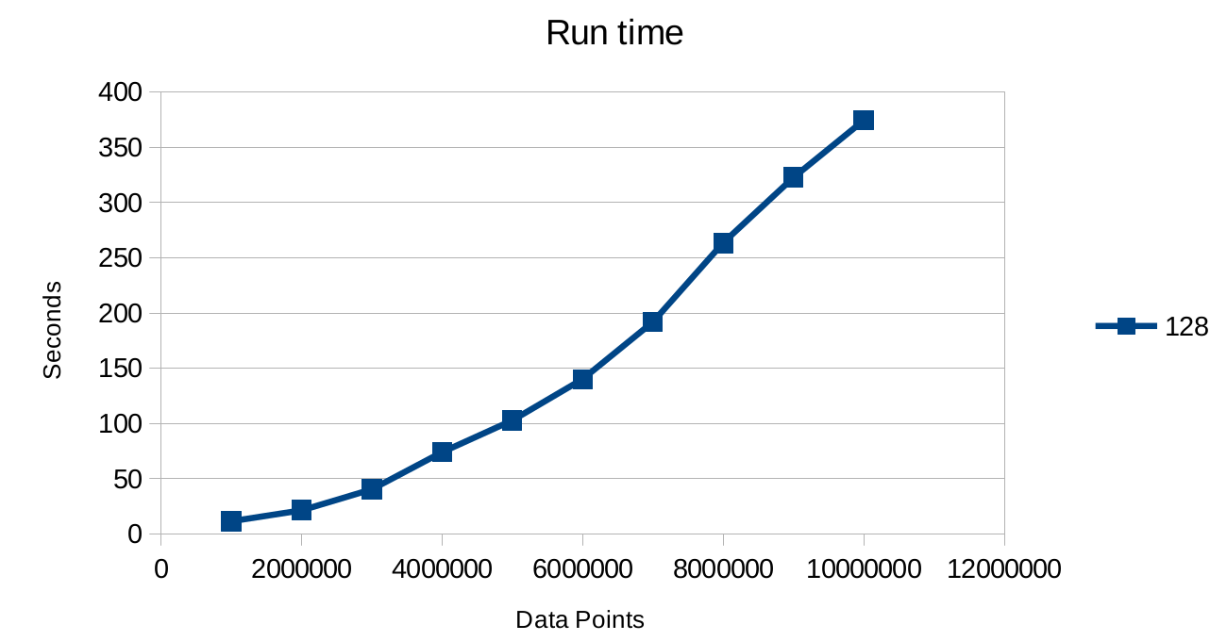
Timing Data

Slide 35
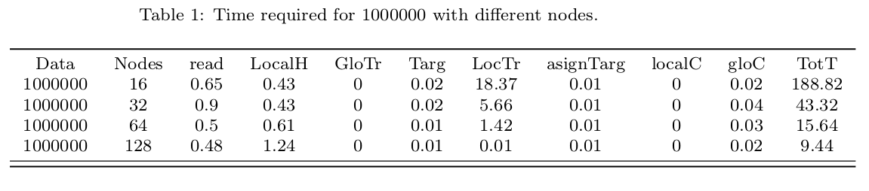
Search Results

Slide 36
Bottleneck
Build Local Tree (when points is large)
Reading data files (when points is large)
Get Local Head (when ranks is large)
Assigning the target (when targets is large)
Local search (when targets is large)

Slide 37
Program Execution
Python script "runTests.py" to run the different test by varying number of ranks, datapoints and target size.
This python script creates qsub file for each run with particular target size, rank and datapoint.
Qlogin for quick test
Git version control.
Each state timing data stored in .txt file
Python code "killprocess.py" that kill the running process for all the used node for qsub job ID.

Slide 38
Challenges
Splitting / Grouping MPI COMM WORLD. (Spent weeks on this)
Print statements
Cluster usage overload.
Memory issue for large data sets and rank.
Recursive call.
Malloc/ Calloc.
Global tree leaves match with local head on each rank.
Get size of target matching, size of target array.

Slide 39
Challenges
Split ranks
Without groups(no barriers)
With groups (with barrier)
Comm Collections
With COMM(ranks<128)
Withouts COMS
Custom Collectives(unstable)
Split ranks(datapoints<1 milions)

Slide 40
Challenges
Print Formats
Reallocate the array

Slide 41
Work Distribution
Gabriel Toban: Adjust Buckets, Round Robin, Integration
Khem Poudel: MPI Comms, Data Read
Toheeb Biala: MPI Functions, Local Sort

Slide 42
Conclusion
Successful implementation of an orthogonal recursive bisection (ORB) of the dataset along N-dimensions with serial and parallel sort.
Implemented for a parallel spatial binary tree that searches millions/ billion points.
Find how many points are within 3 search radii of 20 million targets .

Slide 43
Thank you !!!

